Slide 1
AI based
Smart Shelf Management
for Retailers
TEAM 14
Team Members
Ankit Singh, Nitin Wahie , Mahir Raitani , Anupam Shandilya, Kartikeya Tiwari, Yulin Liu

Slide 2
Shelf Management
Shelf management is one of the biggest problems for both small and big retailers. An optimized shelf leads to the following:
Lower revenues
Customer loss
Inefficient shelf movement
Shelf in occupancy
Notes:
hi

Slide 3
CHALLENGES OF THE RETAIL STORE
Inventory Management
Product Discovery
Consumer Covenience

Slide 4
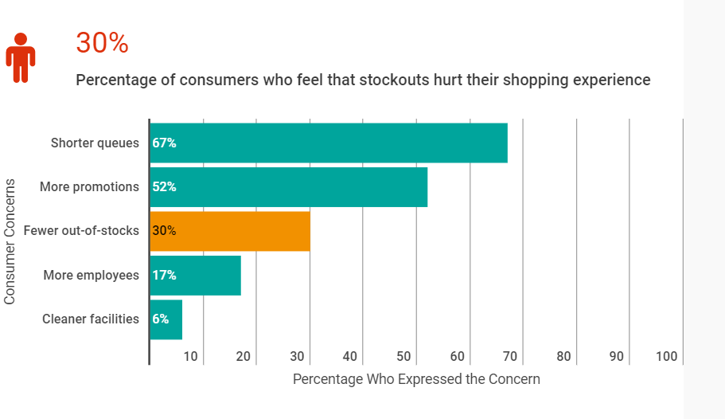
Inventory Management
Why Retailers should care about?
Out-of-stocks are more costly than losing a sale

Slide 5
Loss Due to Out of Stocks
Margin Loss in the thin margin business
In 2018, More than 1 out of 3 Retail Shoppers Attributed bad shopping Experience to Out of Stock. More than 43% these customers opt for another retailer in case of the Out of Stock scenarios in the store.*
15
10
Out of Stocks lead more than 4% loss on the overall annual sales margin for the retailers making it very difficult for them to make profit in the very competitive retail space.*
5
0
Net
Profit
Marketing
Expense
Gross
*https://www.repsly.com/blog/consumer-goods/how-stockouts-can-hurt-your-business
*https://www.supplychaindive.com/news/reduce-retail-out-of-stock-AT-Kearney/545439/

Slide 6
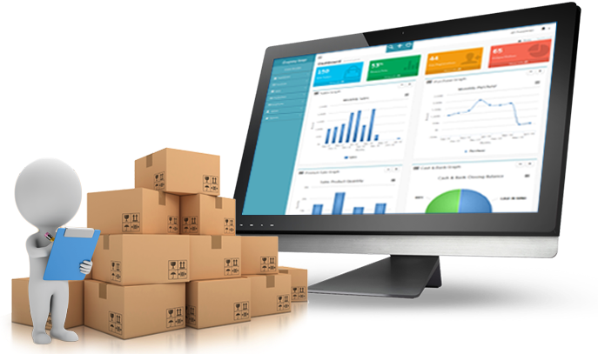




Our Solution
A Strong AI driven Inventory Management for stores
Inventory Assortment
Inventory Tracking
Sales Prediction
Sales Tracking

Slide 7


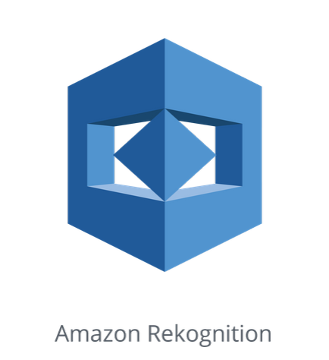







Process flow
Collection, Storage, Analysis
openCV
S3
ReKognition
S3
Athena
Tableau
Image capture and transfer
Image storage
Object recognition and quantity calculation
Structured information stored
Structured query
dashboard

Slide 8
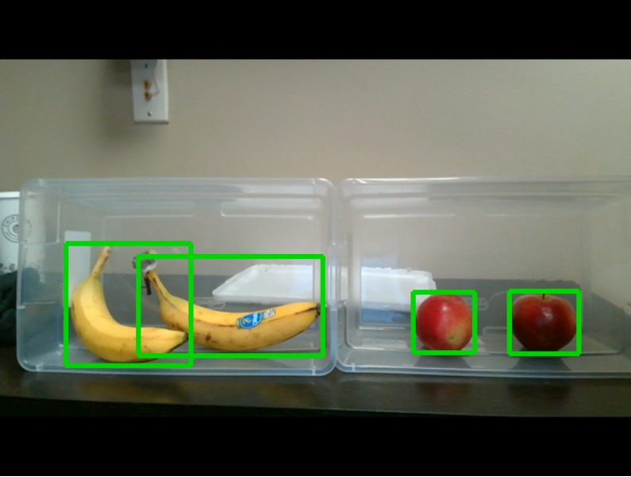
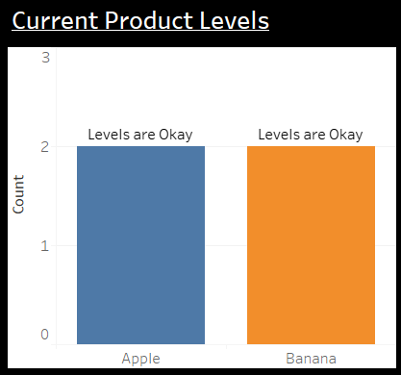
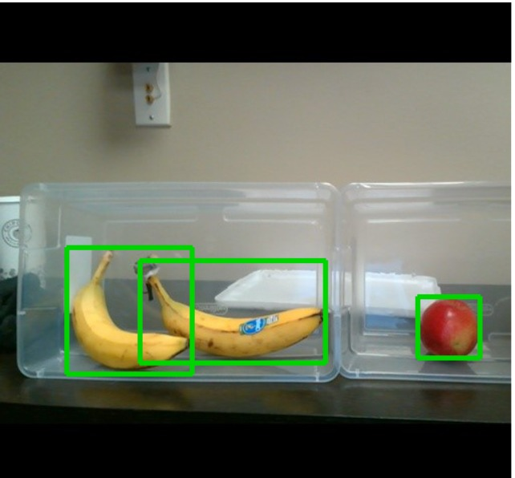
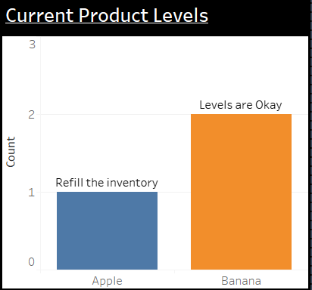
Demonstration

Slide 9
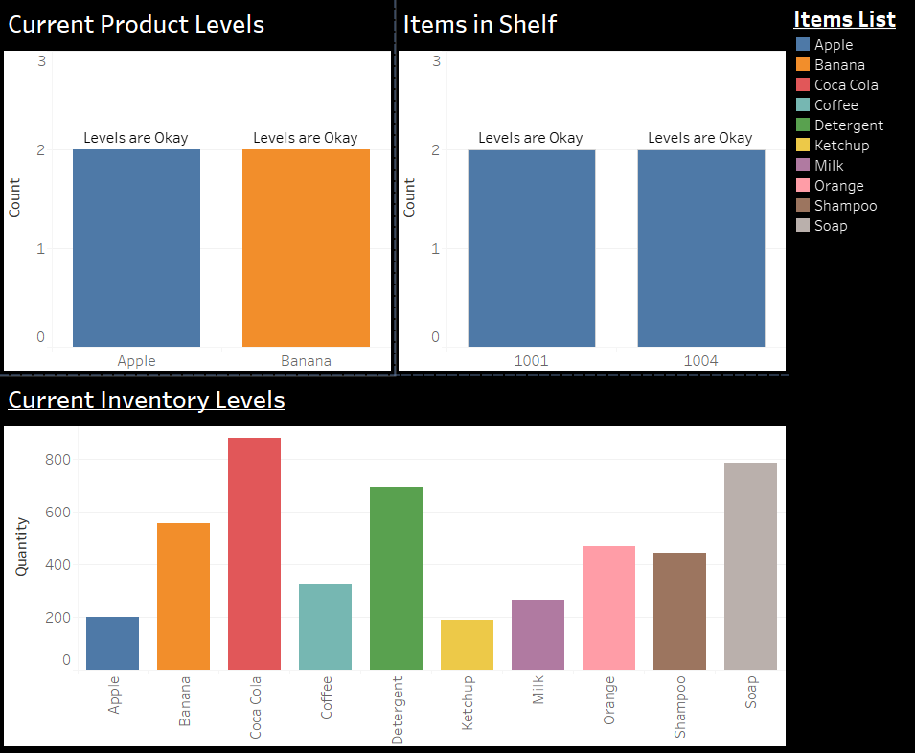
Live Dashboard
Based on object detection algorithm both the items in shelf and quantity as per products are updated on real time image data
Store’s Warehouse Inventory levels are updated based products sold from shelf

Slide 10
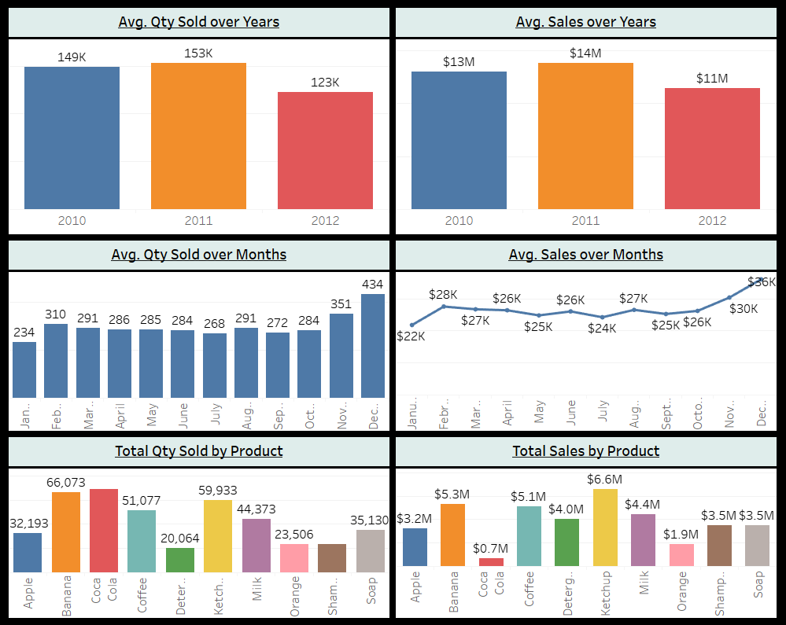
Dashboard from Historical Data
Algorithm’s historical information are stored in Athena Warehouse which can be used to gauge store’s overall health

Slide 11
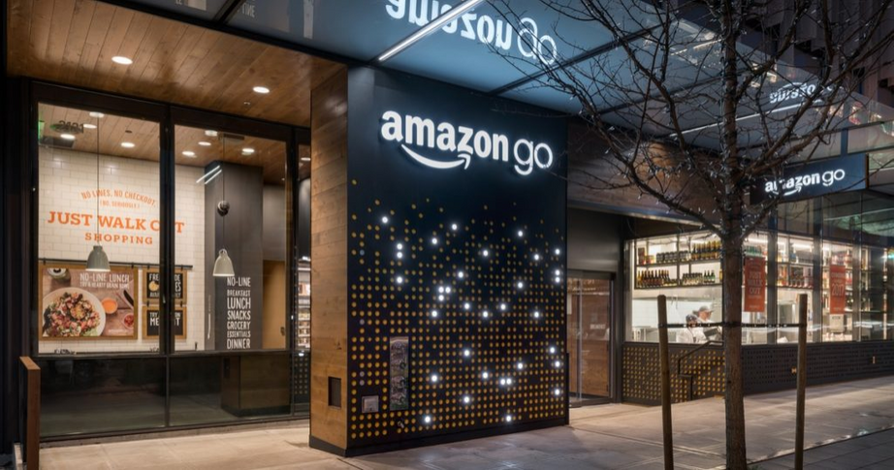
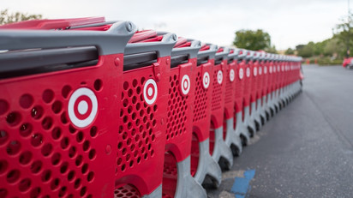
INDUSTRY USE CASES
SIMPLIFIED SHOPPING
DATA DRIVEN RETAIL
Notes:
#track what item people buy
One real example is the Amazon go store.
Amazon go store uses hundreds of ceiling-mounted cameras and electronic sensors to identify each customer and track the items they select. The ceiling cameras have been trained over the past year to differentiate between customers as they move around the store, and between items for sale.
This can simplify the process of customer buying items so that the return rate will increase, too.
#This technique we discuss above can also be used to track the shelf-availability
Data driven :
It is easy to have access to product information and reviews
using computer vision and image recognition can help track on-shelf-availability. The stores can identify patterns that occur as a prelude to or in the aftermath of stock-out scenarios.
And this can also be used to audit product placement, detect trends in product placement, assess compliance and competition and do category analysis.

Slide 12

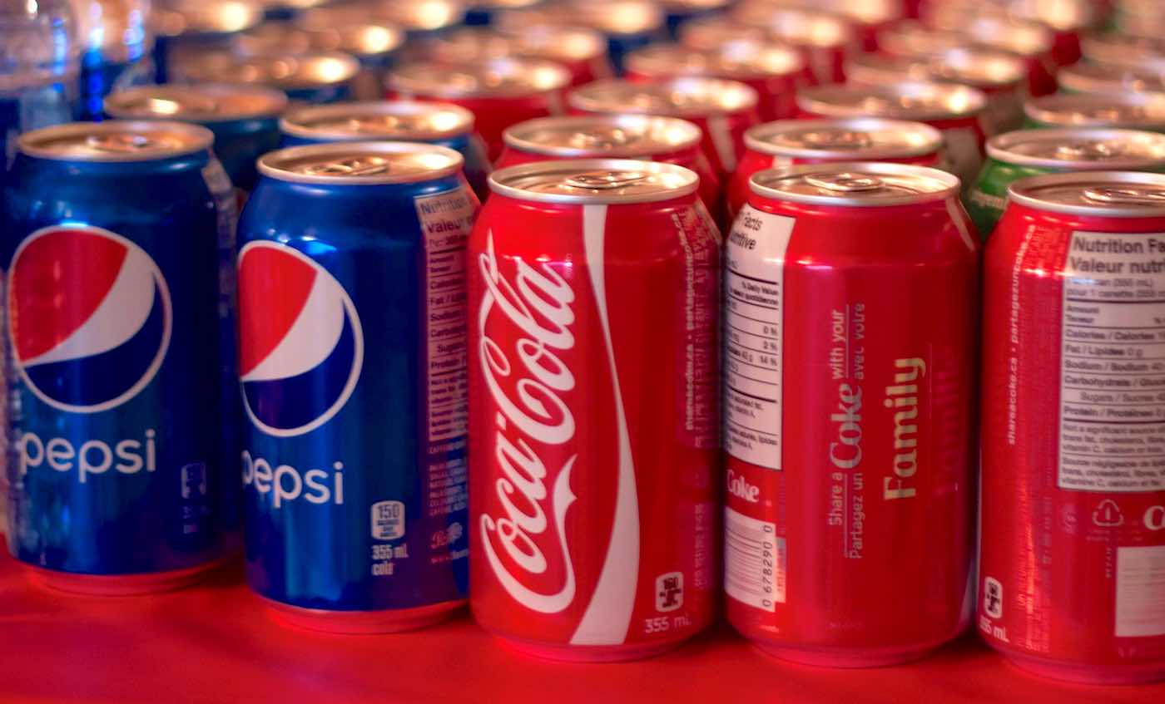
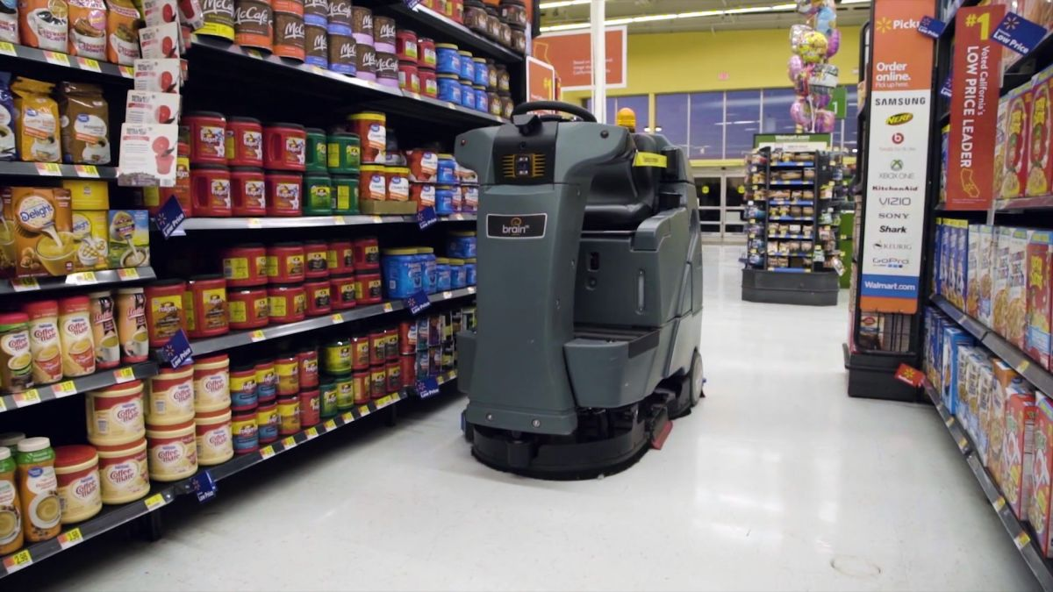
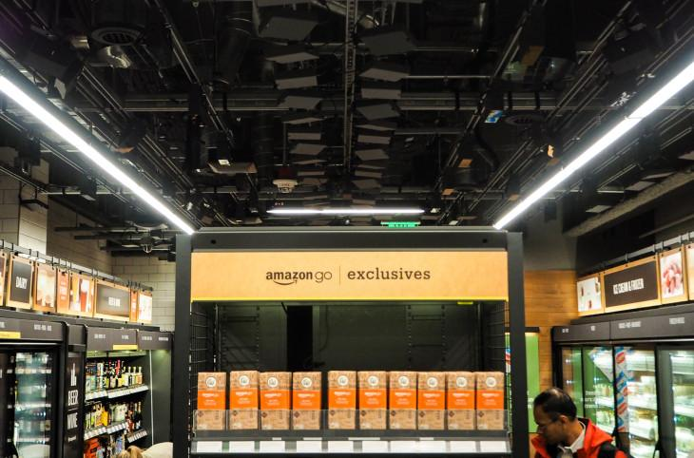
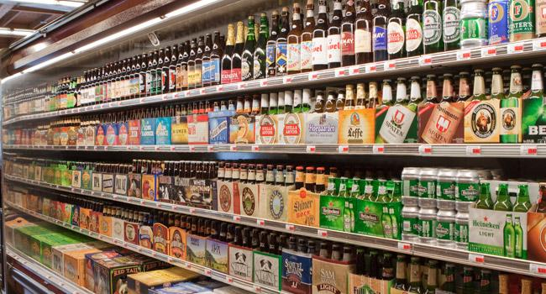
Current Limitations and Future Developments
Train Robust Models
Fully Automated Restocking
Video Streaming
Notes:
Right now we are using pre-trained model provided by Amazon Rekognition Service. It can only identify a limited number of products. For implementing this solution in a store object detection models will have to be trained with images of products which are available in the store. Some other models like YOLO, Fast RCNN can also be used for this.
Another future development is that we can use the output of the model as a signal for robots to refill the shelf item.
Video streaming can be used inplace of taking pictures after fixed interval. The video stream can cover greater number of shelfs and provide real time status of items.

Slide 13
Thank You

